Slide 1
MAL1, Session 2
Regression

Slide 2
Data, algorithms and models (methodology)

Slide 3
Areas of Machine Learning

Slide 4
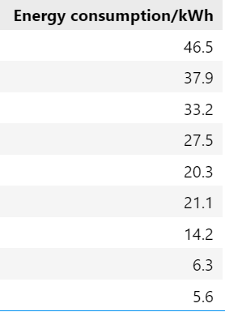
What can we say about these numbers?
y
Min
Max
Average = mean = y hat
Median (middle value)
Mode – the most common
Sum
Variance – the distance to the mean/average
Deviation – standard deviation
We square the variance to make outliers significant
Notes:
3 m's: mean = 23.6, median, mode (variance and standard deviation?)

Slide 5
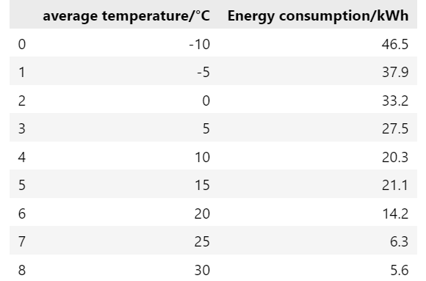
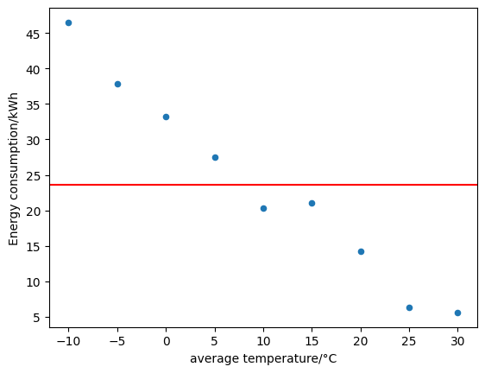
What is a better model?
x
Notes:
y_hat = mean is a model

Slide 6
Variance and standard deviation illustrated
Notes:
Delta_y, Sum(delta) = 0, Sum(|delta|), avg sum delta, sst, var, std

Slide 7
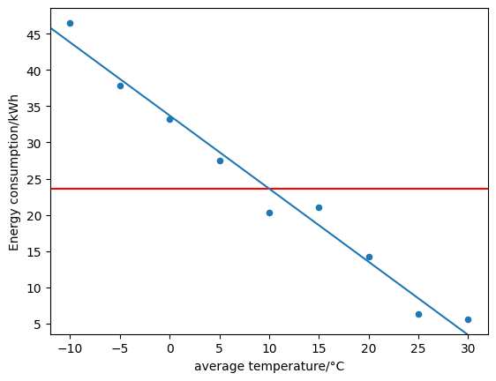
"Best-fitting" straight line
Notes:
y, y_hat, Delta_y, least squares/variance, sum of squared errors

Slide 8
Straight lines and other hyperplanes

Slide 9
Matrix notation

Slide 10
Matrix multiplication

Slide 11
Identity matrix and matrix transformations

Slide 12
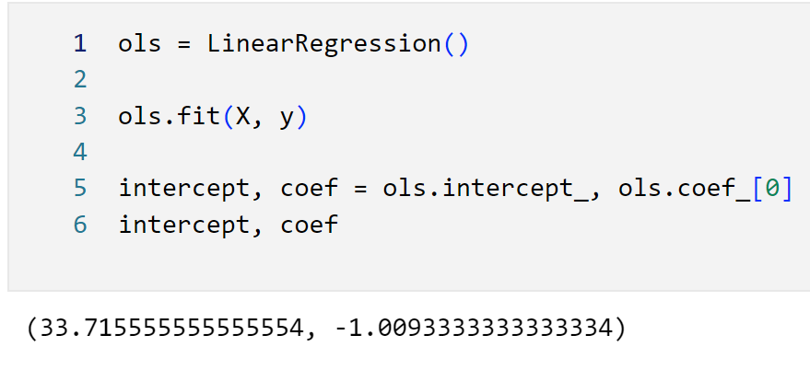
Linear regression in SciKit-Learn

Slide 13
Matrix form

Slide 14
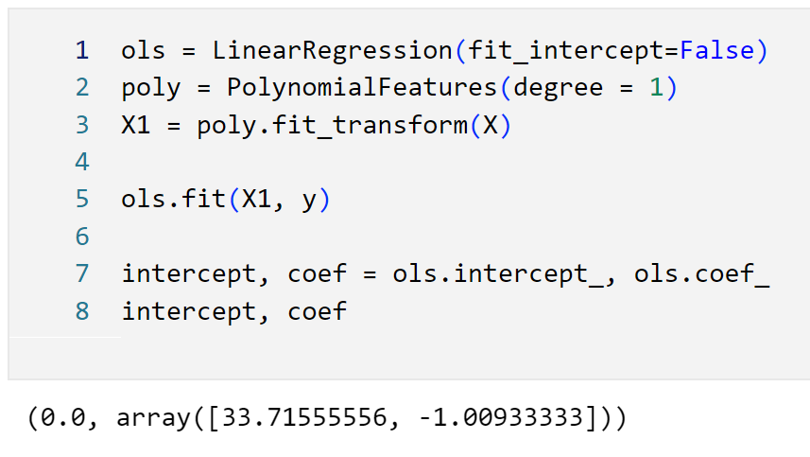
Matrix form in SciKit-Learn

Slide 15
Partial Differentiation and the Chain Rule

Slide 16
Finding the optimum

Slide 17
The matrix multiplication solution in Python (Don't do this)
XT = X1.transpose()
XTX = np.matmul(XT, X1)
XTX1 = np.linalg.inv(XTX)
PseudoInv = np.matmul(XTX1, XT)
Theta = np.matmul(PseudoInv, y.to_numpy())

Slide 18
Model Performance
We optimize by minimizing Sum of Squared Errors (SSE)
Problem: Large datasets give larger SSE
How about Mean of Squared Errors (MSE)?
Problem: Different outcome if we change from kWh to (say) MJ
We need relative SSE.
Relative to what?

Slide 19
R²
Notes:
y, y_hat, Delta_y, least squares/variance, sum of squared errors, loss function

Slide 20
R² in SciKit-Learn
ols.score(X, y)
Notes:
.9764066593305172

Slide 21
Gradient Descent: Searching for the optimum
With linear regression, we can compute the minimal error directly.
Alternatively, we can search for it:
Begin at random parameters
Find the direction where the parameters drop the fastest
Move in that direction proportional to the derivative until done

Slide 22
Gradient descent math

Slide 23
Epochs and Stochastic Gradient Descent

Slide 24
Stochastic Gradient Descent in SciKit-Learn
sgd = SGDRegressor(alpha=.1, max_iter=1000, random_state=504)
sgd.fit(X, y)
y_predict = sgd.predict(X)
plt.scatter(X, y)
plt.plot(X, y_predict, color='r')
sgd.score(X, y)

Slide 25
Other models
Polynomial regression
Ridge
Lasso

Slide 26
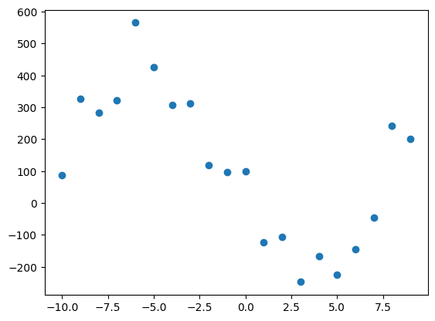
Polynomial regression
Formula:
Depends on the degree
Which degree is this?
Trick: Extra features

Slide 27
Polynomial regression in SciKit-Learn
ols = LinearRegression(fit_intercept=False)
poly = PolynomialFeatures(degree = 2)
X2 = poly.fit_transform(X.reshape(-1, 1))
ols.fit(X2, y)
y_predict = ols.predict(X2)

Slide 28
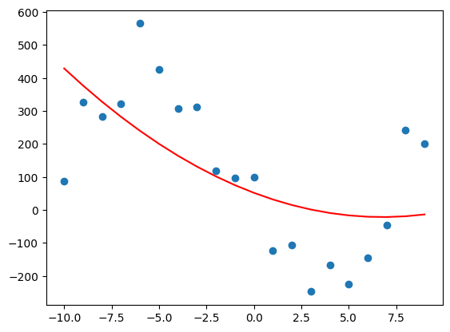
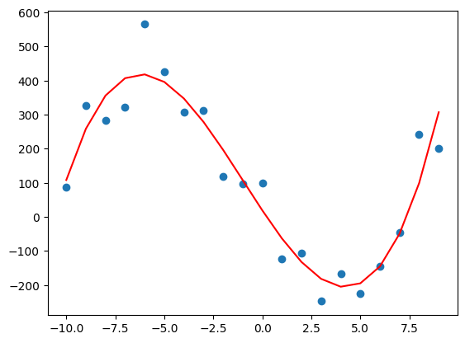
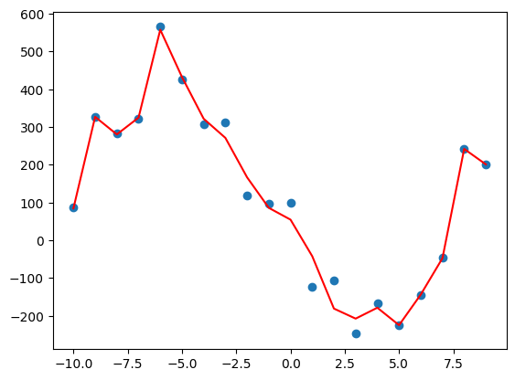
Hyperparameters and under/over-fitting
degree = 2
Score = 0.3896
degree = 3
Score = 0.9053
degree = 15
Score = 0.9803

Slide 29
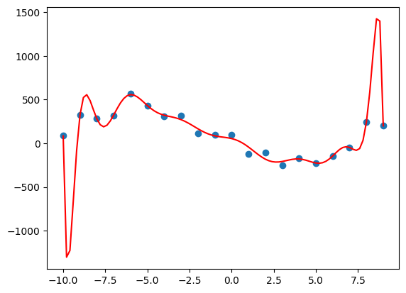
The actual model (degree = 15)

Slide 30
Regularization
Like high polynomial degree, large coefficients is a symptom of overfitting
Change to the loss function: penalize large coefficients
Ridge (l1) regularization: penalize the square of the coefficients
Lasso (l2) regularization: penalize the absolute value of the coefficients

Slide 31
Example: Hitters.ipynb

